Slide 1
Exact Queries
Exact queries match the query patterns with the data
If nothing matches exactly, the query does not retrieve results

Slide 2

Exact Queries (on the Web)
nobel prize winners in literature

Slide 3
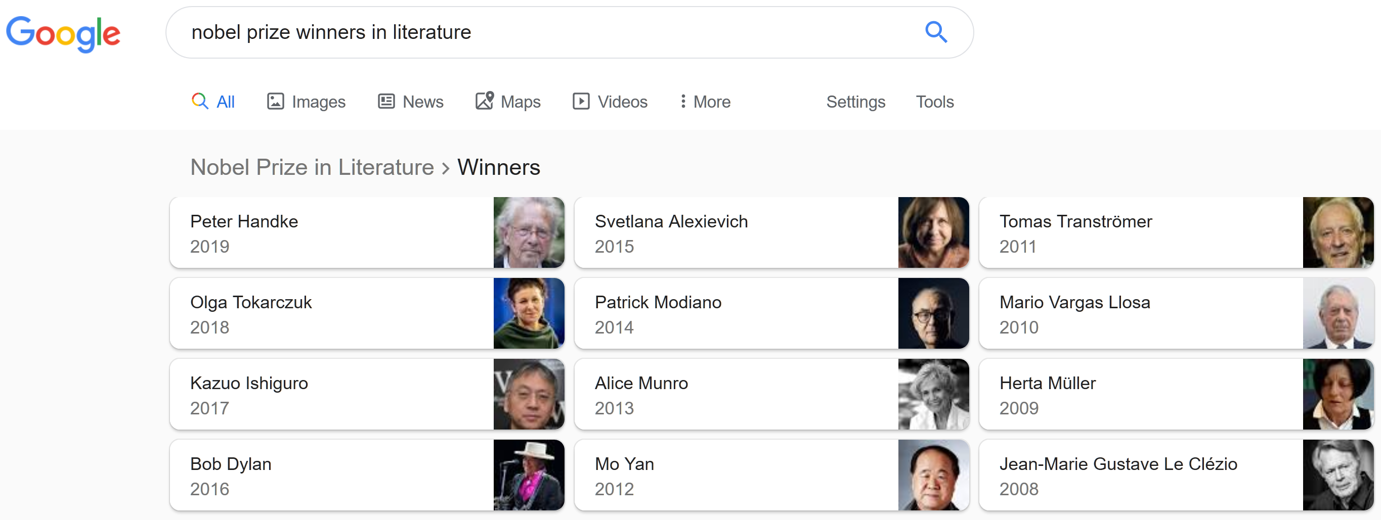
Exact Queries (on the Web)
Notes:
what is the semantic web: part of the cs that aims that web data is machine understandable thus allowing people to express more powerful queries

Slide 4

Exact Queries (on the Web)
nobel prize winners in literature that fought in a war

Slide 5
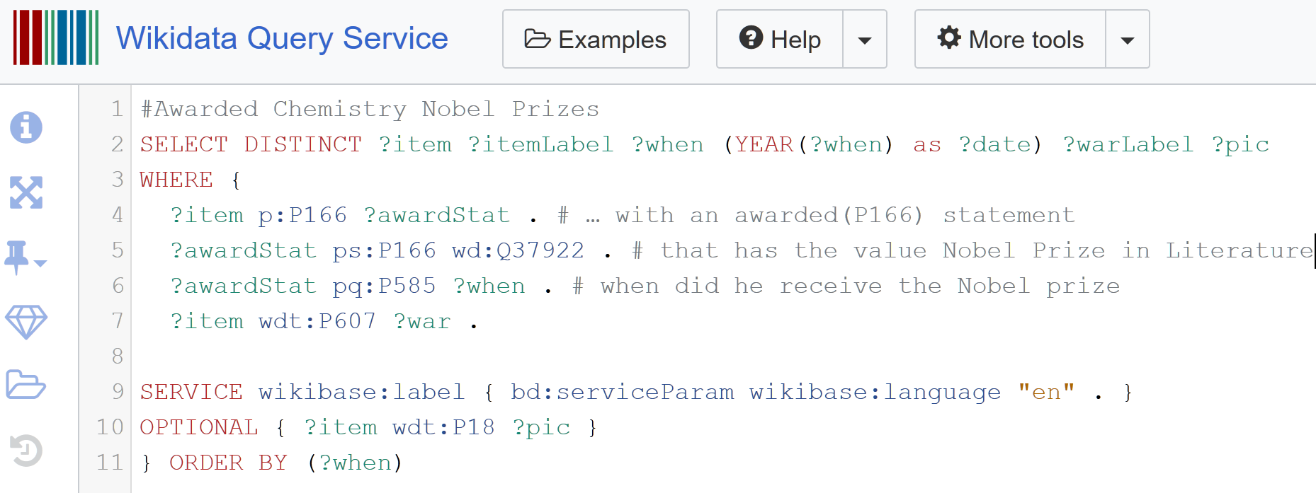
Exact Queries (on the Semantic Web)

Slide 6
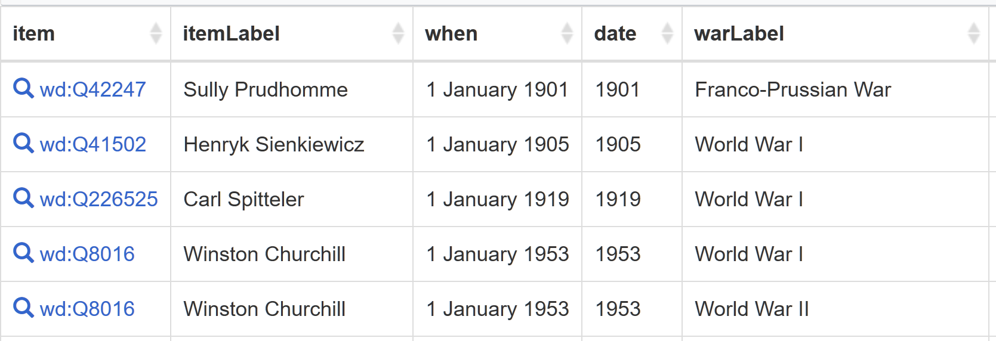
Exact Queries (on the Semantic Web)

Slide 7
Similarity Queries
Similarity queries retrieve objects that are similar to the query, not necessarily matching exactly

Slide 8
Similarity Queries (on the Web)
books similar to harry potter

Slide 9

Similarity Queries (on the Web)

Slide 10
Similarity Queries (on the Web)
Latin American countries with similar population and GDP to Ireland

Slide 11
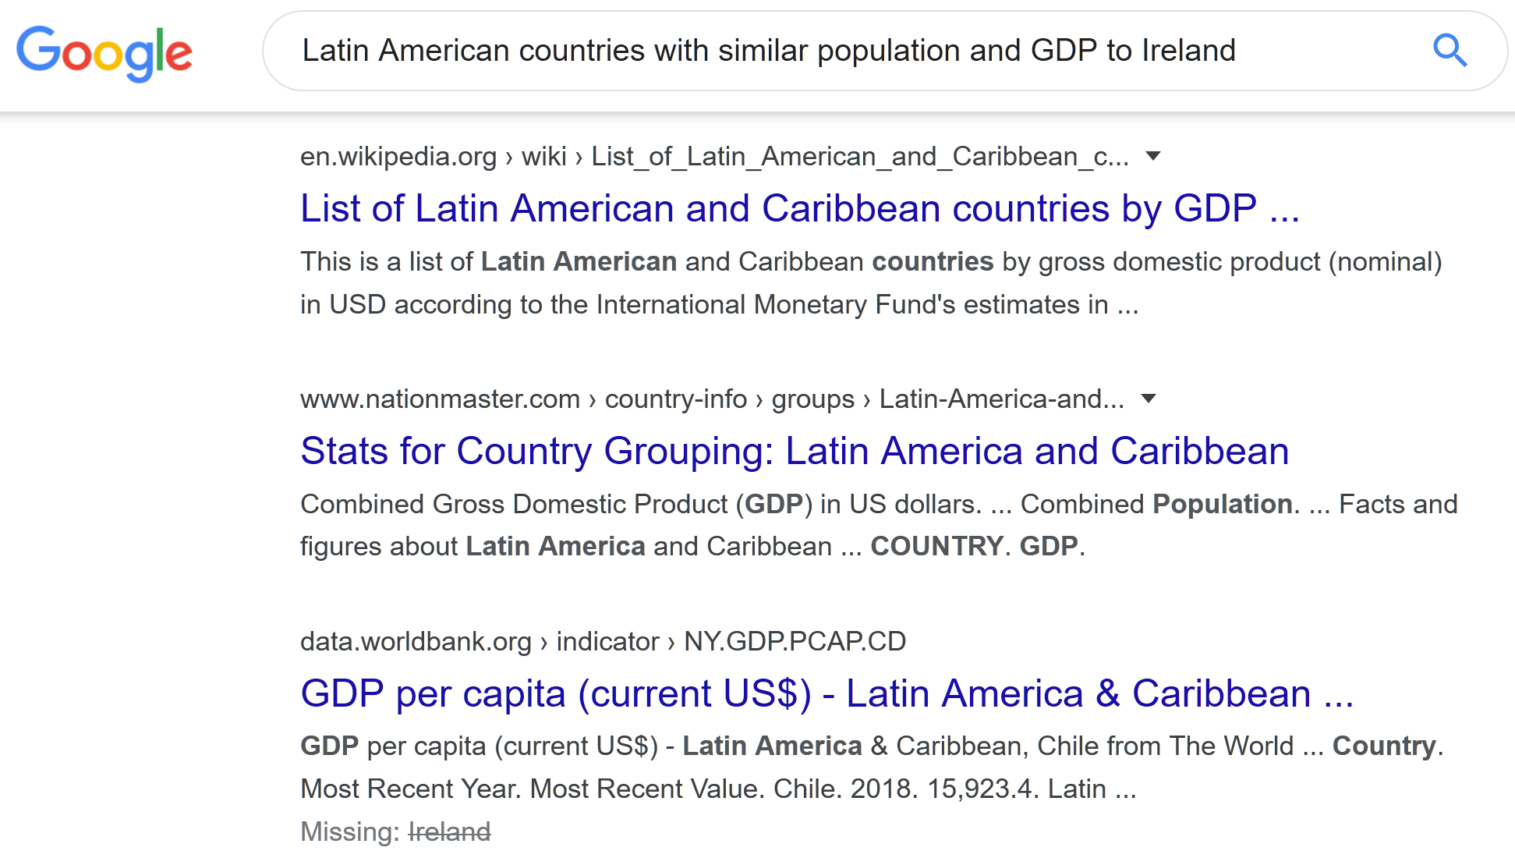
Similarity Queries (on the Web)

Slide 12


Extending SPARQL with Similarity Joins
Sebastián Ferrada, Benjamin Bustos and Aidan Hogan
IMFD, DCC, Universidad de Chile
International Semantic Web Conference – Research Track

Slide 13
1.- The Goal

Slide 14
To provide users with means for executing similarity queries in the Semantic Web context

Slide 15
2.- Definitions

Slide 16
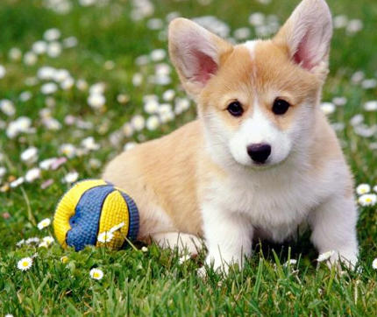

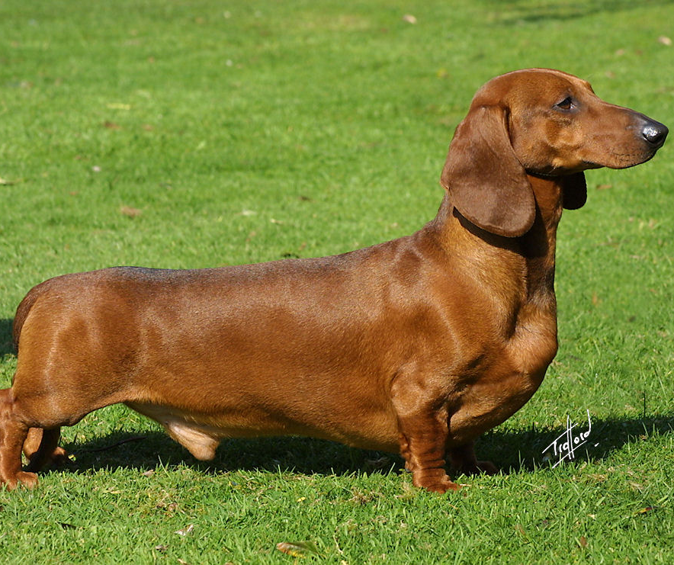
Similarity
Similarity among objects depends on many factors:
The application goals
Human appreciation
The nature of the object
Semantic contexts
Many more...

Slide 17
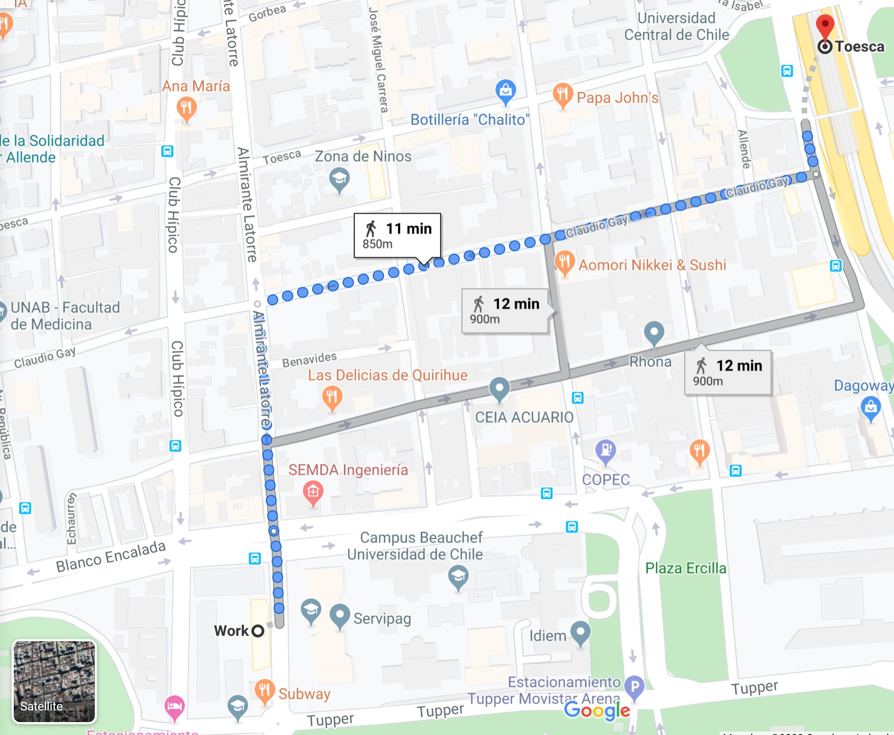
Similarity – Distance Functions
We focus on distances as a similarity measure.
Mainly metric distances
750m

Slide 18
Two objects are as similar as they are close in their metric space

Slide 19
Similarity Joins
Given two datasets, their similarity join contains all pairs of similar objects, one of each dataset

Slide 20
Similarity Join – Range-based
r
Find all pairs ( , ) that are at distance of at most r

Slide 21
Similarity Join – Nearest Neighbours
k=3
Find all pairs ( , ) such that is one of the k nearest neighbours of

Slide 22
Similarity Join
Note that a brute force algorithm computing the join will verify that each pair of objects satisfies the similarity criteria, which is a nested loop

Slide 23
Similarity Join – Example
Find pairs of Latin American and European countries with the most similar GDP and Human Development Index
Panama
Portugal
Chile
Germany
Peru
Mexico
Slovakia
Argentina
Montenegro
Ireland
El Salvador
HDI
Brazil
Greece
Ecuador
France
Bolivia
Russia
GDP

Slide 24
3.- Similarity Joins in SPARQL

Slide 25
We propose to extend SPARQL to support a similarity join operator

Slide 26


State-of-the-art
Paper | Language | System | Multi- dimensional | Range Queries | Knn Queries | Subquadratic | Semantic
[Silva et al., 2013] | SQL | DBSimJoin
[Kiefer et al., 2007] | SPARQL 1.0 | iSPARQL
[Galkin et al., 2017] | SPARQL 1.1 | MSimJoin
[Ferrada et al., 2020] | SPARQL 1.1 | SJ-SPARQL

Slide 27
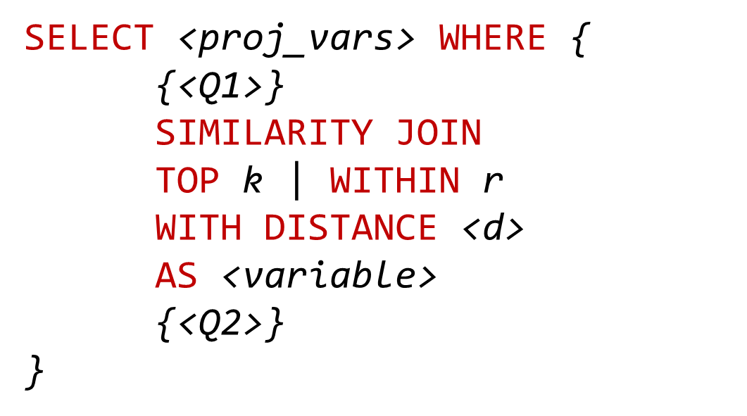
Query Evaluation Pipeline
Query Writing
Parsing
Optimisation
Execution
Result Iteration

Slide 28
SPARQL Grammar Extension
SimilarityGraphPattern ::= 'SIMILARITY JOIN ON (' Var+ ') (' Var+ ')' ('TOP' INTEGER |'WITHIN' DECIMAL ) 'DISTANCE' iri 'AS' Var GroupGraphPattern
GraphPatternNotTriples ::= GroupOrUnionGraphPattern |...| SimilarityGraphPattern

Slide 29
SPARQL Syntax Extension – Example
SELECT ?p1 ?p2 ?d WHERE {
{?p1 wdt:P31/wdt:P279* wd:Q6256 ; #countries
wdt:P4010 ?GDP1 ;
wdt:P1081 ?hdi1 ;
wdt:P30 wd:Q46 } #in Europe
SIMILARITY JOIN ON (?GDP1 ?hdi1) (?GDP2 ?hdi2)
TOP 1 DISTANCE sim:manhattan AS ?d
{?p2 wdt:P31/wdt:P279* wd:Q6256 ; #countries
wdt:P4010 ?GDP2 ;
wdt:P1081 ?hdi2 ;
wdt:P361 wd:Q12585 }} #in LATAM
Latin American countries with a similar GDP and HDI of European Countries

Slide 30
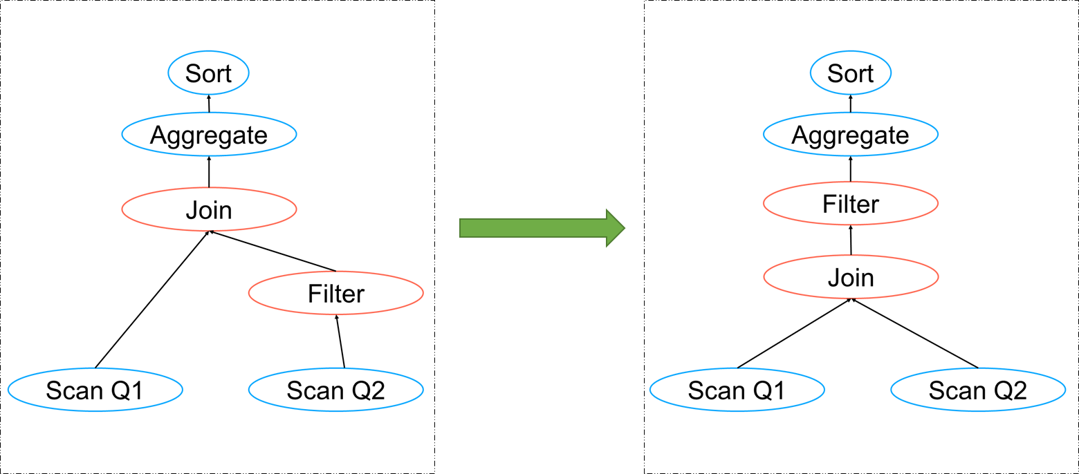
Query Evaluation Pipeline
Query Writing
Parsing
Optimisation
Execution
Result Iteration

Slide 31
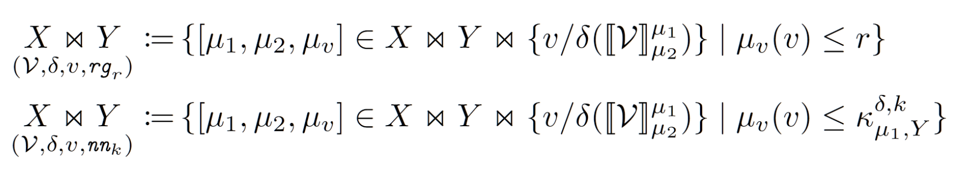
Algebra Operator
Definition 1. Given two sets of solution mappings X and Y, the evaluation of the similarity joins are defined as:

Slide 32
Query Evaluation Pipeline
Query Writing
Parsing
Optimisation
Execution
Result Iteration

Slide 33
Query Overlap Cache
SELECT ?p1 ?p2 ?d WHERE {
{?p1 wdt:P31/wdt:P279* wd:Q6256 ; #countries
wdt:P4010 ?GDP1 ;
wdt:P1081 ?hdi1 ;
wdt:P30 wd:Q46 } #in Europe
SIMILARITY JOIN ON (?GDP1 ?hdi1) (?GDP2 ?hdi2)
TOP 1 DISTANCE sim:manhattan AS ?d
{?p2 wdt:P31/wdt:P279* wd:Q6256 ; #countries
wdt:P4010 ?GDP2 ;
wdt:P1081 ?hdi2 ;
wdt:P361 wd:Q12585 }} #in LATAM

Slide 34
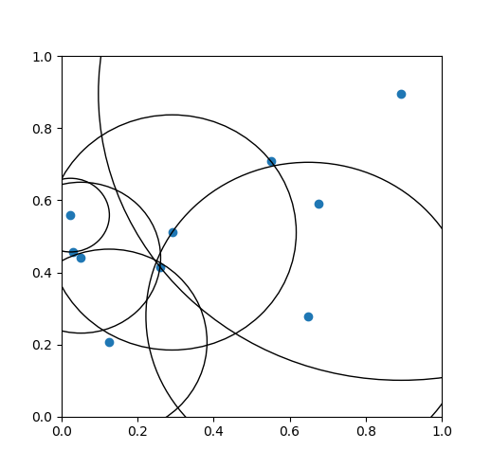
Query Evaluation Pipeline
Query Writing
Parsing
Optimisation
Execution
Result Iteration

Slide 35
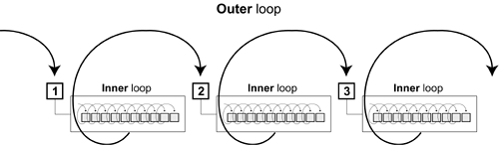
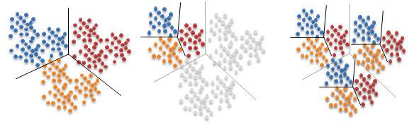
Similarity Join Strategies
Nested Loop
Vantage-point trees
FLANN

Slide 36
Strategy Comparison
1000 scenarios taken from the characteristic sets of Wikidata
Varying number of entities and properties
Self-similarity join on all properties

Slide 37
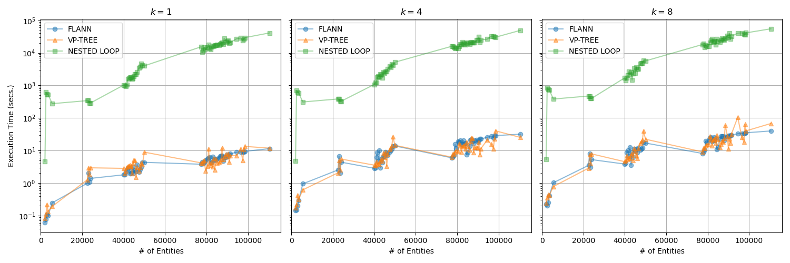
Strategy Comparison

Slide 38
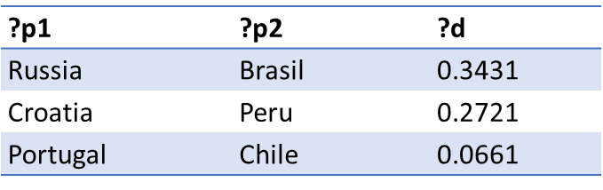
Query Evaluation Pipeline
Query Writing
Parsing
Optimisation
Execution
Result Iteration

Slide 39
4.- Use-case Queries
Notes:
wikidata has 4.632.440.812 truthy triples

Slide 40

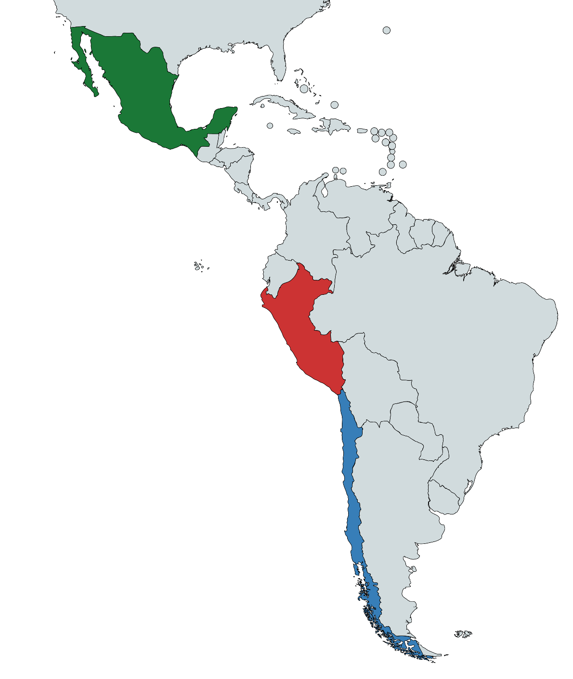
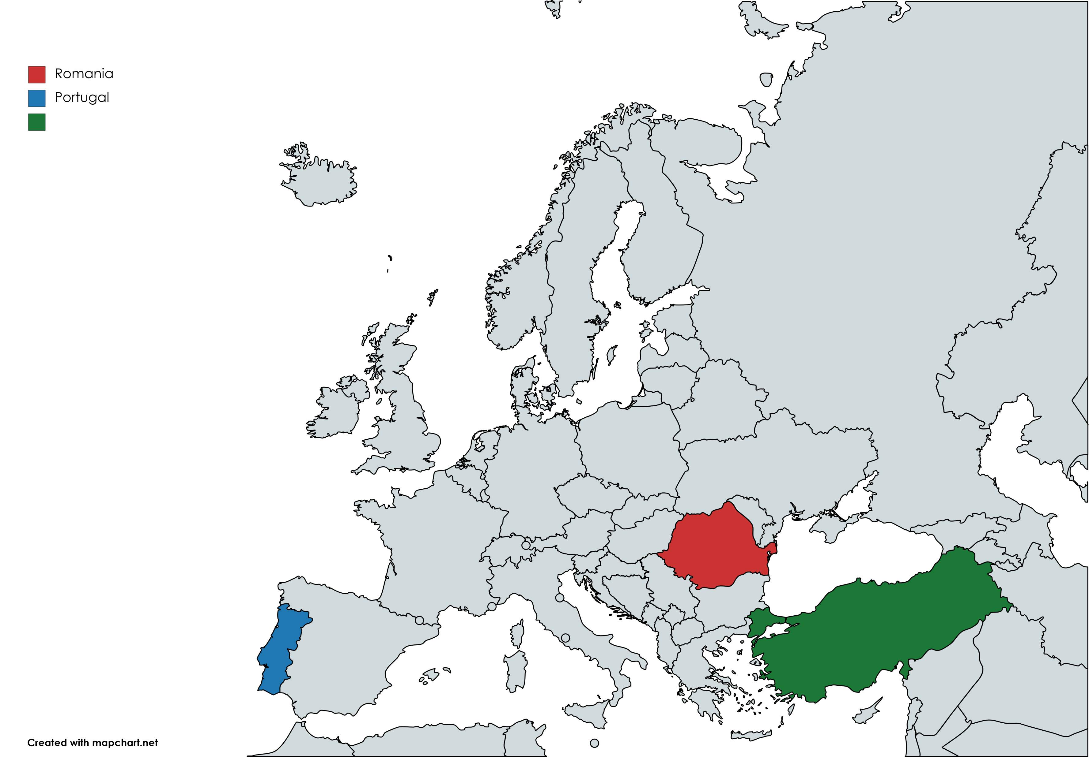
Country Similarity
?p1 | ?p2 | ?d
Romania | Peru | 0.129
Portugal | Chile | 0.134
Turkey | Mexico | 0.195
European countries similar to Latin American countries based
on welfare indicators
Notes:
Life expectancy, Nominal GDP, GDP, GDP growth rate, HDI

Slide 41
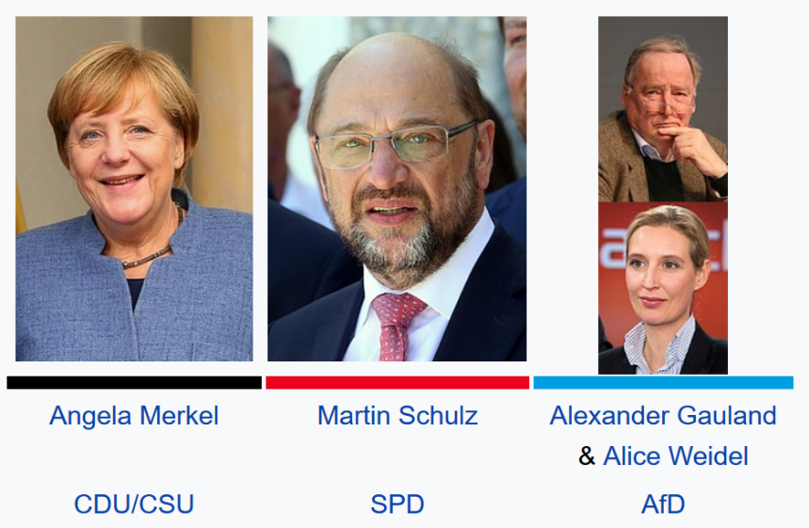
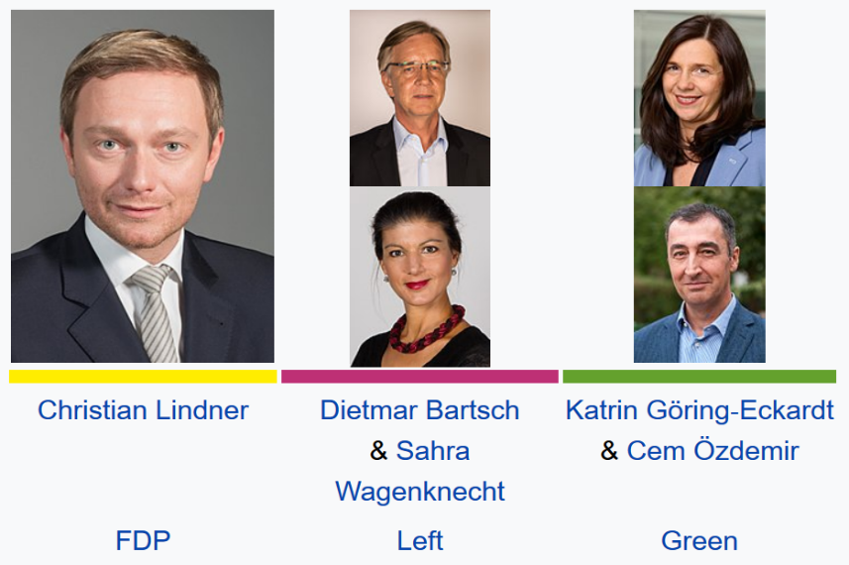
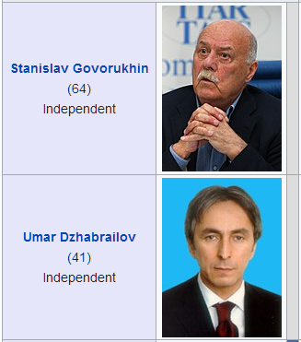
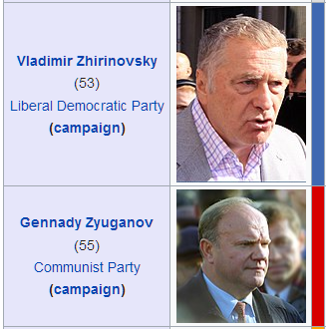
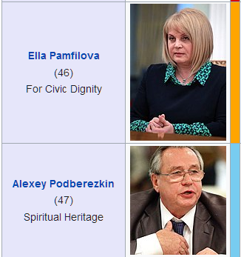
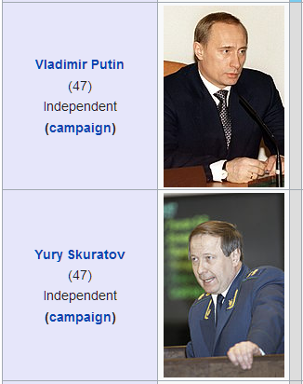
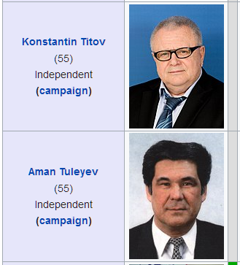
Aggregated Dimensions
The two most similar elections in terms of number of candidates,
different parties and different political philosophies

Slide 42

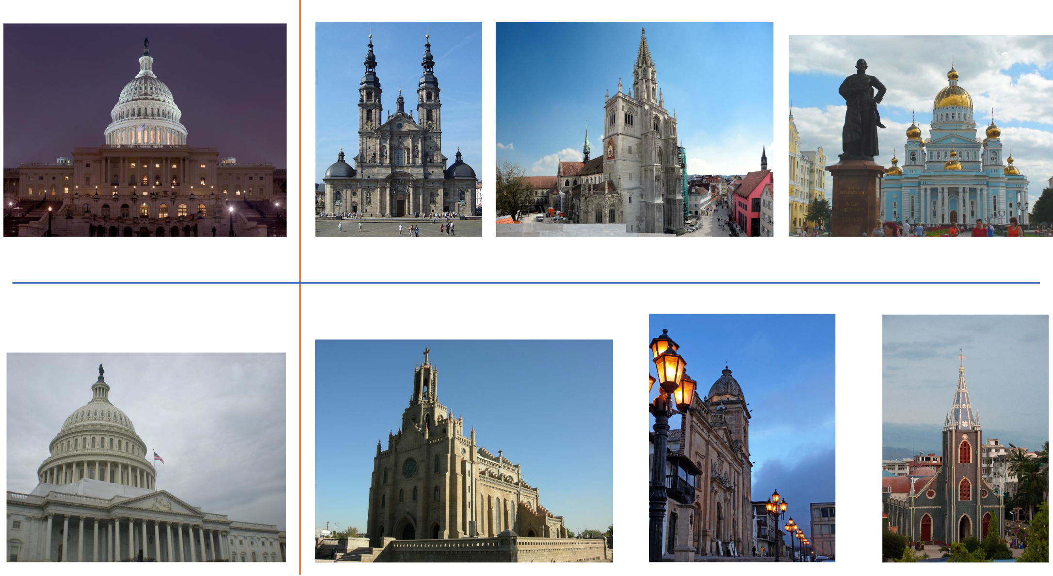
Image Similarity
Images of churches similar to images of the US Capitol building

Slide 43
Potential Use Cases
Data Integration
Entity Linking
Query Relaxation
Text Mining

Slide 44
5.- Implementation

Slide 45

Apache Jena
Open source SPARQL engine and
RDF storage system
Our implementation is integrated in Jena, providing all the required interfaces and objects to parse and execute similarity joins
Result iteration follows the fetch-as-needed philosophy of other operators
Notes:
Grammar compiled with JavaCC
Optimises and executes algebra trees
Results fetched as needed
It allows normal flow of non-similarity queries, our implementation only takes over to solve similarity joins
Nested loops, vp-trees, flann and quickjoin solvers are implemented
This behaviour avoids the storage of a possible quadratic number of results

Slide 46
6.- Evaluation

Slide 47
Related Works – iSPARQL
SELECT ?pub1 ?pub2 ?sim WHERE {
?pub1 rdfs:label ?title1 ;
opus:book_title ?booktitle1 .
?pub2 swrc:label ?title2 ;
swrc:book_title ?booktitle2 .
IMPRECISE {
?sim1 isparql:jac (?title1 ?title2).
FILTER (?sim1 >= 0.5) .
?sim2 isparql:lev (?booktitle1 ?booktitle2).
FILTER (?sim2 >= 0.5) .
?sim isparql:score (?sim1 ?sim2 0.6 0.4).
FILTER (?sim >= 0.5)}
} ORDER BY DESC(?sim)

Slide 48
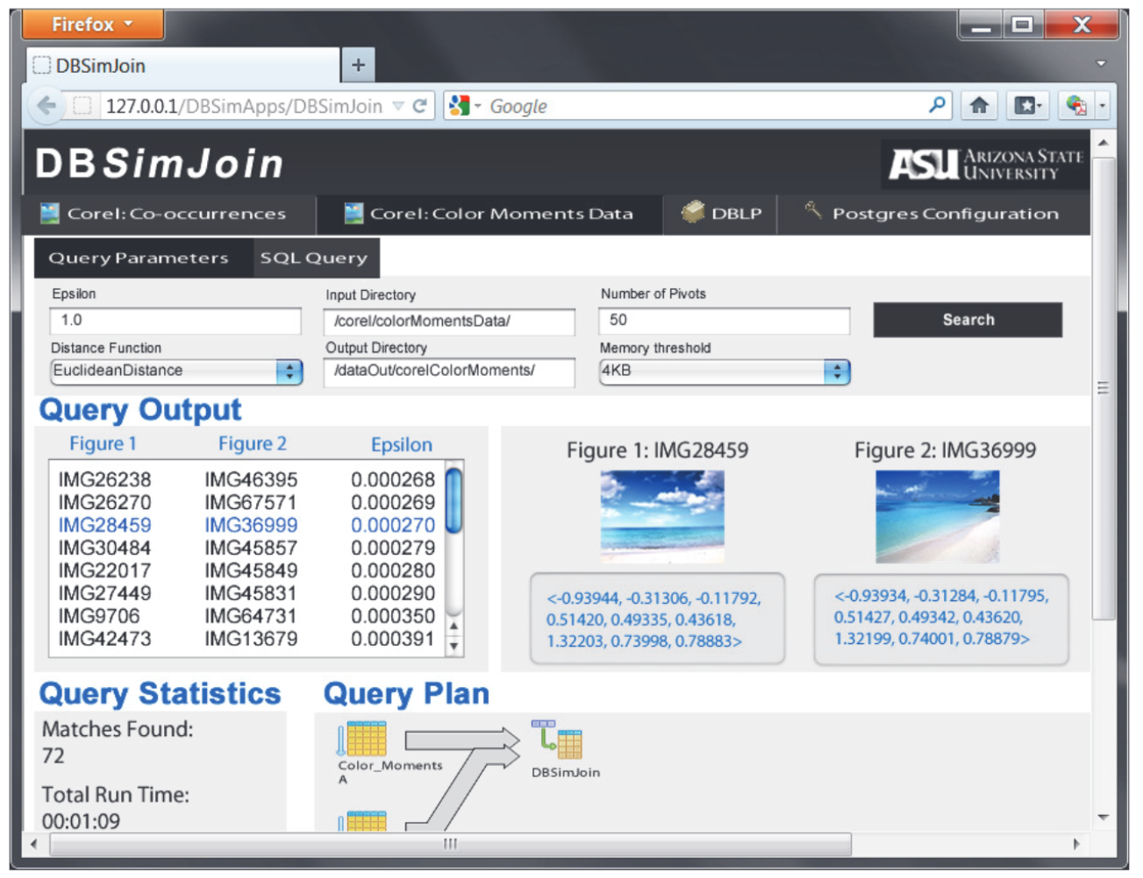
Related Works – DBSimJoin
G
L
r
r

Slide 49
System Evaluation – iSPARQL
Compared to iSPARQL our implementation has the following advantages:
It is more efficient – avoids nested loops
It requires less memory – avoids virtual triples
It can handle an arbitrary number of properties instead of using pairwise property similarities

Slide 50
System Evaluation – DBSimJoin
We compared our system to DBSimJoin.
DBSimJoin implements Quickjoin. We compared with our implementation with VP-trees.
We use the same setup that on DBSimJoin Paper, and used increasingly larger values for the search radius

Slide 51
System Evaluation

Slide 52
System Evaluation

Slide 53
System Evaluation

Slide 54
7.- Conclusions & the Future

Slide 55
Conclusions
We presented the design, implementation and evaluation of a system supporting similarity queries over RDF Datasets
Query Writing
Parsing
Optimisation
Execution
Result Iteration
Notes:
We propose novel syntax and semantics to add a similarity join operator to SPARQL
We provide an open implementation of similarity joins on top of Apache Jena
We illustrate several use-case queries
We show the system outperforms the state-of-the-art

Slide 56
Lessons Learnt
Similarity joins are an useful feature for SPARQL
Range queries are unintuitive in abstract metric spaces; providing k-nn is key, but it is harder to implement
Similarity joins can take up to quadratic time, but we show that their computation is feasible in practice
Syntax is tricky to define, specially since similarity joins require many parameters

Slide 57
Lessons Learnt
A SPARQL/RDF setting raises unique challenges for similarity queries, namely, the need for normalisation, the consideration of unbound, missing and multiple values, etc.
It would be interesting to see similarity joins adopted in future versions of SPARQL, especially since version 1.2 is on discussions

Slide 58


Future Work
Perform experiments on the usability of the syntax and the system, compared with standard SPARQL

Slide 59

Future Work
Experiment with different query rewritings and other query optimisation techniques

Slide 60

Future Work
Find other relevant use-cases or domains that can benefit from this tool. Ideas are welcome!

Slide 61
Extending SPARQL with Similarity Joins
Sebastián Ferrada, Benjamin Bustos and Aidan Hogan
IMFD, DCC, Universidad de Chile
International Semantic Web Conference – Research Track

Slide 62
SPARQL Query – Similar Countries
SELECT ?c1 ?c2 ?d WHERE{
{?c1 wdt:P31 wd:Q6256 ; # Countries
wdt:P2250 ?lifex1 ; wdt:P2131 ?ngdp1 ; # Life expectancy, Nominal GDP
wdt:P4010 ?gdp1 ; wdt:P2219 ?growth1 ; # GDP, GDP growth rate
wdt:P1081 ?hdi1 ; wdt:P361 wd:Q12585} # HDI, Latin America
SIMILARITY JOIN
ON (?lifex1 ?ngdp1 ?gdp1 ?growth1 ?hdi1)
(?lifex2 ?ngdp2 ?gdp2 ?growth2 ?hdi2)
TOP 1 DISTANCE sim:manhattan AS ?d # 1-nn using Manhattan
{?c2 wdt:P31 wd:Q6256 ; # Countries
wdt:P2250 ?lifex2 ; wdt:P2131 ?ngdp2 ; # Life expectancy, Nominal GDP
wdt:P4010 ?gdp2 ; wdt:P2219 ?growth2 ; # GDP, GDP growth rate
wdt:P1081 ?hdi2 ; wdt:P30 wd:Q46}} # HDI, Europe

Slide 63
SPARQL Query – Similar Elections
SELECT ?e2 ?c1 ?c2 ?p1 ?p2 ?d WHERE{
{SELECT (wd:Q15062956 AS ?e1)
(COUNT(DISTINCT ?candidate) AS ?c1)
(COUNT(DISTINCT ?party) AS ?p1)
(COUNT(DISTINCT ?ideology) AS ?i1) WHERE{
wd:Q15062956 wdt:P726 ?candidate . # candidates
?candidate wdt:P102 ?party . ?party wdt:P1387 ?ideology.}} # parties, ideologies
SIMILARITY JOIN ON (?c1 ?p1 ?i1) (?c2 ?p2 ?i2)
TOP 4 DISTANCE sim:manhattan AS ?d # 4-nn using Manhattan
{SELECT ?e2 (COUNT(DISTINCT ?candidate) AS ?c2)
(COUNT(DISTINCT ?party) AS ?p2)
(COUNT(DISTINCT ?ideology) AS ?i2) WHERE{
?e2 wdt:P31/wdt:P279* wd:Q40231 ; wdt:P726 ?candidate . # elections, candidates
?candidate wdt:P102 ?party . ?party wdt:P1387 ?ideology . # parties, ideologies
} GROUP BY ?e2}}

Slide 64
SPARQL Query – Similar Images
SELECT ?img1 ?img2 WHERE{
{?img1 imo:associatedWith wd:Q54109 . # Capitol Building
?vector1 a imo:HOG ;
imo:describes ?img1 ;
imo:value ?hog1 .} # HOG descriptor
SIMILARITY JOIN ON (?hog1) (?hog2) TOP 3
DISTANCE sim:manhattan AS ?d # 3nn w/ Manhattan
{?cathedral wdt:P31 wd:Q2977 . # Cathedrals
?img2 imo:associatedWith ?cathedral .
?vector2 a imo:HOG ;
imo:describes ?img2 ;
imo:value ?hog2 .}} # HOG descriptor

